Slide 1
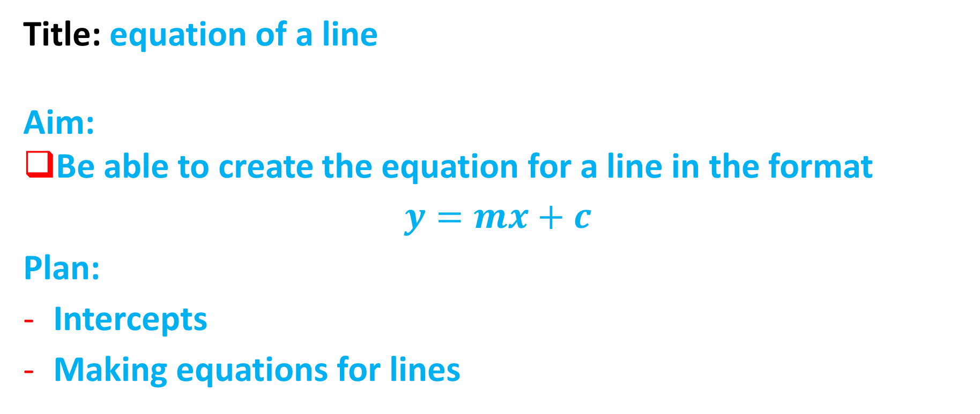
Lesson objective
Title: equation of a line
Aim:
Be able to create the equation for a line in the format
$$y=mx+c$$
Plan:
Intercepts
Making equations for lines

Slide 2
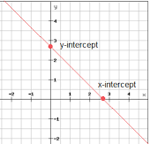
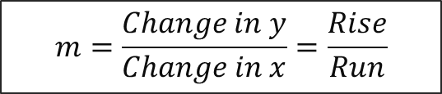
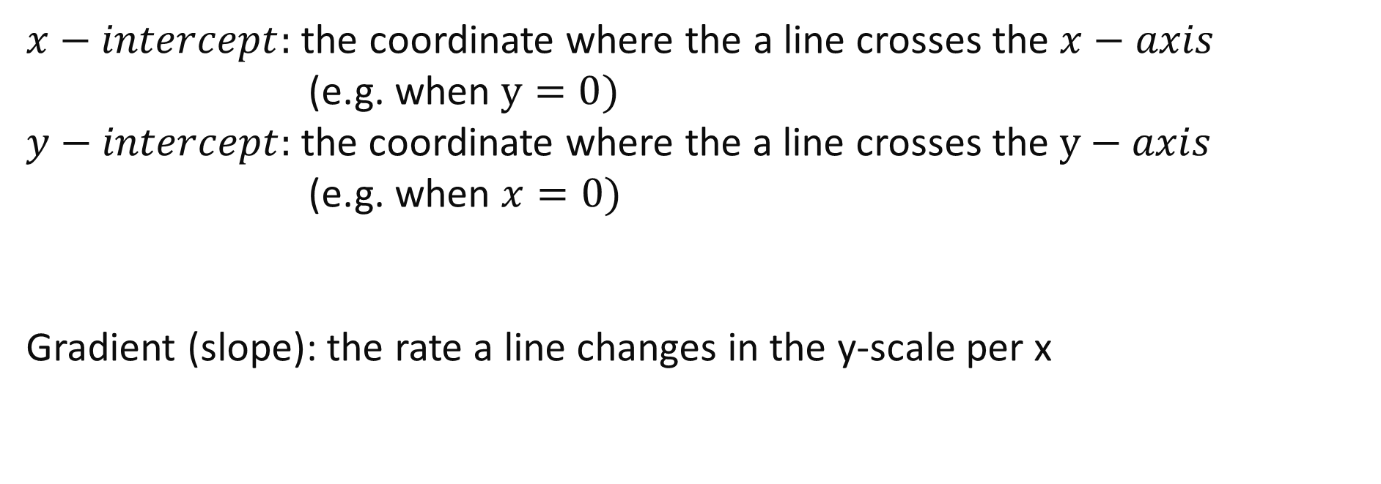
Daily Review
$x−intercept:$ the coordinate where the a line crosses the $x−axis$
(e.g. when $y=0)$
$y−intercept:$the coordinate where the a line crosses the $y−axis$
(e.g. when $x=0)$
Gradient (slope): the rate a line changes in the y-scale per x
$$m=\frac{Change in y}{Change in x}=\frac{Rise}{Run}$$

Slide 3
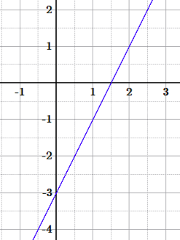
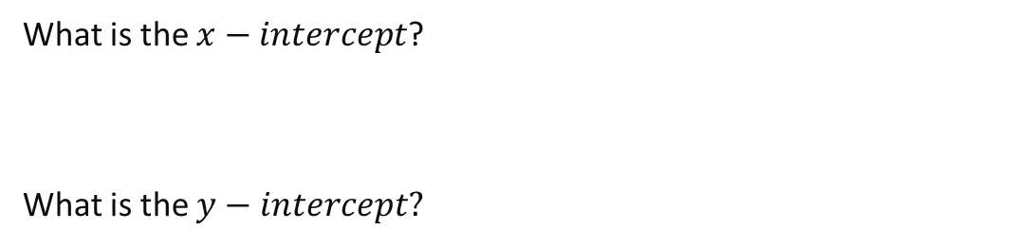
Daily Review
Whiteboards
What is the $x−intercept$?
What is the $y−intercept?$

Slide 4
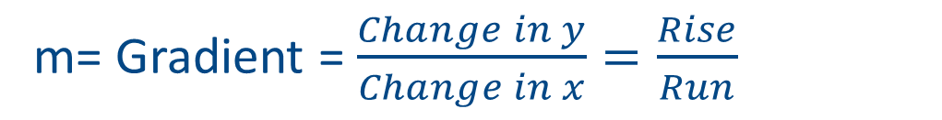
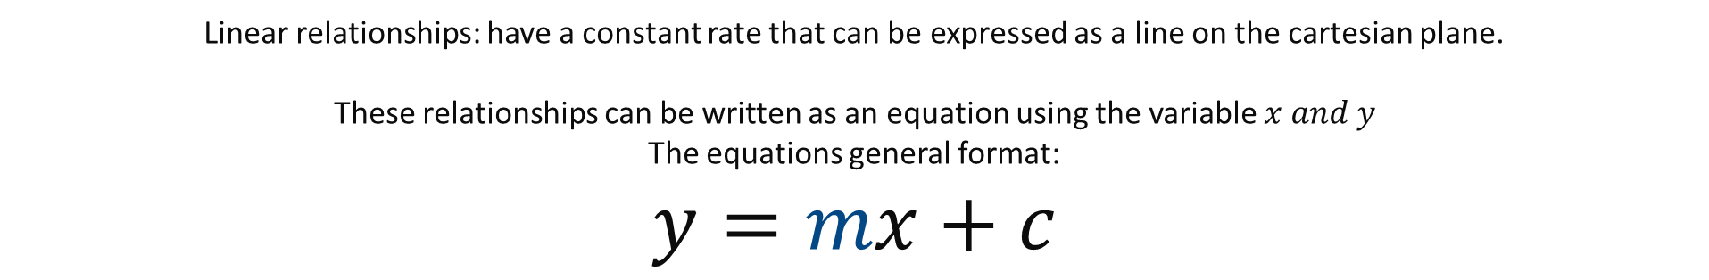
Linear relationships: have a constant rate that can be expressed as a line on the cartesian plane.
These relationships can be written as an equation using the variable $x and y$
The equations general format:
$$y=mx+c$$
m= Gradient = $\frac{Change in y}{Change in x}=\frac{Rise}{Run}$
C= what the y-intercept is (for y)

Slide 5
y=x + 2
I Do
y=mx + c
8
7
6
5
4
1
1
2
2
3
2
1
-1
-2
-3
-4
-5
-6
-7
-8
Next

Slide 6
y=2x + 4
I Do
y=mx + c
8
7
2
6
2
4
4
5
4
3
2
1
-1
-2
-3
-4
-5
-6
-7
-8
Next

Slide 7
y=-3x + 2
I Do
y=mx + c
8
7
-3
6
-3
2
2
5
4
3
2
1
-1
-2
-3
-4
-5
-6
-7
-8
Next

Slide 8
y=-2x - 2
I Do
y=mx + c
8
7
-2
6
-2
5
4
3
2
1
-1
-2
-2
-2
-3
-4
-5
-6
-7
-8
Next

Slide 9
y=0.5x + 2
I Do
y=mx + c
8
7
6
5
4
1up
2
2
3
2
1
1÷2=0.5
0.5
-1
2 right
-2
-3
-4
-5
Remember –
Up or down ÷ across
-6
-7
-8
Next

Slide 10
y= x+ 5
I Do
y=mx + c
2
3
8
7
5
6
5
5
4
2up
3
2
1
2÷3=2/3
2/3
-1
3 right
-2
-3
-4
-5
Remember –
Up or down ÷ across
-6
-7
-8
Next

Slide 11
We Do
y=-3x + 4
Whiteboards
8
7
6
5
4
3
2
1
-1
-2
-3
-4
-5
-6
-7
-8
Next

Slide 12
We Do
y=-3x + 4
Whiteboards
Your turn!
What is the equation of this line?
8
7
6
5
4
3
2
1
-1
-2
-3
-4
-5
-6
-7
-8
Next

Slide 13
We Do
y=2x + 1
Whiteboards
Your turn!
What is the equation of this line?
8
7
6
5
4
3
2
1
-1
-2
-3
-4
-5
-6
-7
-8
Next

Slide 14
We Do
y=-4x -4
Whiteboards
Your turn!
What is the equation of this line?
8
7
6
5
4
3
2
1
-1
-2
-3
-4
-5
-6
-7
-8
Next

Slide 15
We Do
y=x + 3
Whiteboards
Your turn!
What is the equation of this line?
8
7
6
5
4
3
2
1
-1
-2
-3
-4
-5
-6
-7
-8
Back

Slide 16

y=$\frac{3}{2}$x + 4
We Do
y=mx + c
Whiteboards
8
7
6
5
4
3up
4
4
3
2
1
3÷2
-1
2 right
-2
-3
-4
-5
Remember –
Up or down ÷ across
-6
-7
-8
Next

Slide 17
y=1/3x + 4
We Do
y=mx + c
Whiteboards
8
7
6
5
4
1up
4
4
3
2
1
1÷3=1/3
1/3
-1
3 right
-2
-3
-4
-5
-6
Remember –
Up or down ÷ across
-7
-8
Next

Slide 18
y=-0.5x + 3
We Do
y=mx + c
Whiteboards
8
7
6
5
4
1 DOWN
3
3
3
2
1
-1÷2=-0.5
-0.5
-1
2 right
-2
-3
-4
-5
Remember –
Up or down ÷ across
-6
Remember –
Down is negative
-7
-8
Next

Slide 19
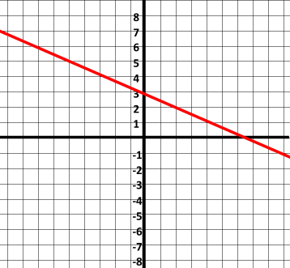
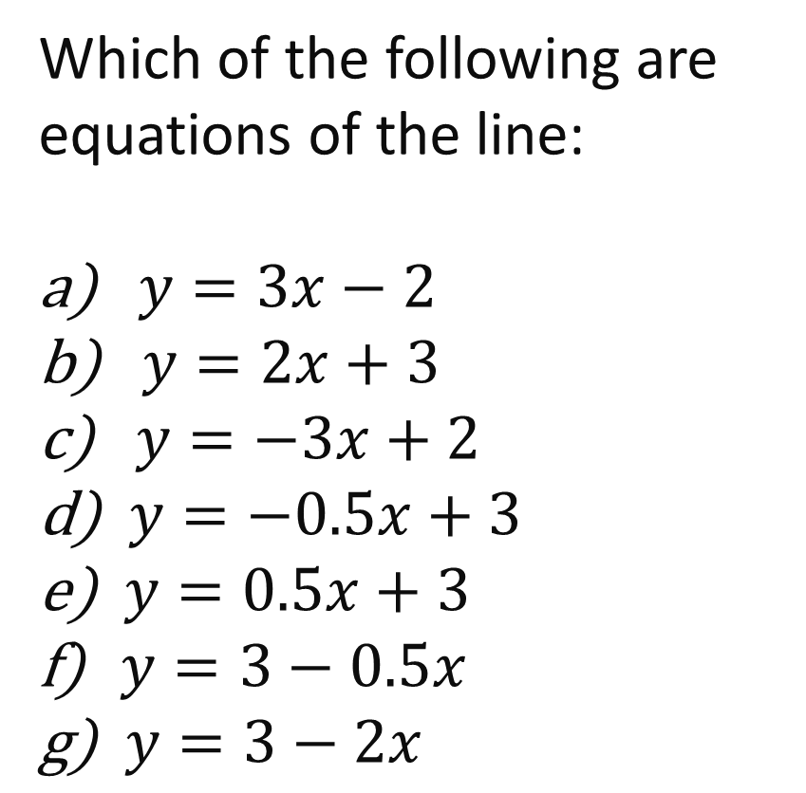
Which of the following are equations of the line:
$y=3x−2$
$y=2x+3$
$y=−3x+2$
$y=−0.5x+3$
$y=0.5x+3$
$y=3−0.5x$
$y=3−2x$

